Slide 1
Reactive Systems Java & Reactive Programming
James.Fennell@lit.ie
Reference for this lecture
Adam L. DavisReactive Streams in Javahttps://doi.org/10.1007/978-1-4842-4176-9_1

Slide 2
Reactive Streams
Reactive Streams is an initiative to provide a standard for asynchronous stream processing with non-blocking back pressure.
This encompasses efforts aimed at runtime environments (JVM and JavaScript) as well as network protocols.
reactive-streams.org

Slide 3
Reactive Streams
Reactive Streams are an effort to provide
highly responsive applications
able to handle many requests per second
the ability to manage backpressure
the ability to skip or queue data that is coming too fast to be processed
Asynchronous means processing can take place in many threads
without stopping to read data from a file or a web request for example

Slide 4
Reactive Streams
Many implementations already exist for asynchronous processing
e.g. Java’s Future, CompletableFuture, and parallel streams
most do not support asynchronous handling of backpressure
Reactive Streams are a unifying standard interface that abstracts existing methods of concurrency
A standard interface allows different Reactive Streams implementations can interoperate in one application

Slide 5
Java 9
Java 9 was an important release of Java
Language updates
Support for Reactive Streams
a unified interface for Reactive Streams
Modularity (Project Jigsaw)
Provided compile-time errors for missing dependencies instead of runtime errors
Java REPL (jshell)
What we will focus on!

Slide 6
Java 9 - Flow
Support for Reactive Streams has been added to the JDK
Several interfaces have been added in the java.util.concurrent.Flow class:
Publisher<T> : A producer of items (and related control messages) received by Subscribers
Subscriber<T> : A receiver of messages
Processor<T,R> : A component that acts as both a Subscriber and Publisher
Subscription : Message control linking a Publisher and Subscriber

Slide 7
Java 9 - Flow
No implementation for these interfaces are included in the JDK
however, several third party implementations already exist.
Implementations of the Reactive Streams specification on the Java virtual machine (JVM) are:
Project Reactor (part of Spring 5)
Akka Streams
RxJava

Slide 8
Java 9 - Alternative Models of Concurrency
The fundamental model for concurrency in Java is the Thread
As multicore processors increasingly important, different Models for using Threads have been implemented
Each of these models has a different approach to protecting values from being modified by more than one thread at one time

Slide 9
Java 9 - Alternative Models of Concurrency
There are several tried and true models of concurrency in Java and the JVM
Synchronize and suffer (using synchronize keyword in Java)
Futures and the ExecutorService
Software transactional memory (STM) (Clojure)
Actor-based model (Akka)
Reactive Streams (RxJava, Reactor, etc.)

Slide 10
Alternative Models of Concurrency Synchronize
Originally concurrent programming in Java used the synchronized keyword whenever shared resources are modified
only one thread can access the resource at a given point of time
You must deal with the following problems:
No warnings or errors are given at compile time
Deadlocks can occur if you’re not careful
It’s very difficult to test – runtime errors occur randomly

Slide 11
Alternative Models of Concurrency Java Futures
java.util.concurrent.Future interface in Java (since 1.5)
It holds the result of an asynchronous computation.
It contains methods to check
if the asynchronous computation is complete or still in progress
to wait for the completion of the computation
to block the call until the completion of the computation (with optional timeout)
to retrieve the result of the computation

Slide 12
Alternative Models of Concurrency Java Futures - Drawbacks
Tendency to loop on isDone() or call get()
isDone() ties up the thread
get() blocks the thread completely
We need a callback – to remove the need for polling isDone()
Asynchronous methods should always return void
For these reasons, if you do any concurrent programming, you should use the CompletableFuture introduced in Java 8

Slide 13
Alternative Models of Concurrency CompletableFuture
The CompletableFuture<T> implements the Future<T> interface as well as a CompletionStage<T> interface
The CompletionStage<T> interface fills in many of the deficiencies of Future<T>
These methods follow the functional style, allowing the developer to chain method calls
rather than declaring a step-by-step process

Slide 14
Alternative Models of Concurrency Actors
The Scala-based actor framework Akka can also be used from Java.
Akka is also used by the Play Framework
It includes the concept of Actors.
Actors can receive and process messages and are guaranteed to receive messages sent to them.
They process each message one at a time so their state is shielded from the rest of the system

Slide 15
Alternative Models of Concurrency Actors
An Actor is designed to run in a dedicated thread, so it can only do one thing at a time
This makes concurrency much easier to implement
Messages are passed around to Actors and wait in a queue until the given Actor is ready to process it
A message can be any Serializable object
Single Thread Actors with shielded state working on one message at a time eliminates many of the issues concurrency causes

Slide 16
Alternative Models of Concurrency Reactive Streams
Reactive Streams provide an abstraction for highly concurrent, asynchronous applications with support for backpressure
Reactive Systems can be used with any of the preceding models of concurrency
Attempt to provide enough functionality to be sufficient for any implementation
Run in multithreaded way, so ensure thread safety if you modify shared state
Try to avoid using other methods (e.g., using a LockingTransaction or synchronize block) and instead stay within the Reactive Streams model
Functional Programming and/or the Actor Model in conjunction with Reactive Streams will avoid the potential pitfalls of concurrency

Slide 17
Alternative Models of Concurrency Reactive Streams
Reactive Streams use the concepts of publisher and subscriber, along with various strategies for backpressure to model concurrency
A publisher emits events at some rate.
A subscriber observes those events on possibly a different thread and does something with them.
Most Reactive Streams frameworks allow interoperation with other existing models of concurrency, such as futures, to allow a smooth transition between the two.

Slide 18
Flow API
The Flow class is part of the java.util.concurrent package
It helps developers incorporate reactive programming in their applications
The class has one method - defaultBufferSize()
and four interfaces that correspond to the Reactive Streams API
https://docs.oracle.com/en/java/javase/12/docs/api/java.base/java/util/concurrent/Flow.html
The defaultBufferSize() is a static method that returns the default buffer size for publishing and subscribing buffering
This default value is 256 and it is returned as an int

Slide 19
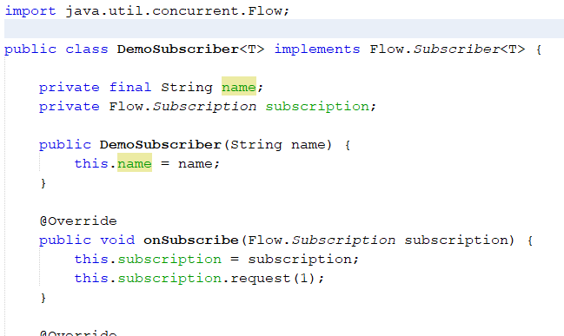
Build Pub Sub Architecture using the Flow API
Create a demo subscriber
Use the constructor to assign a name to the subscriber
Pass in the Subscription object through the onSubscribe method

Slide 20
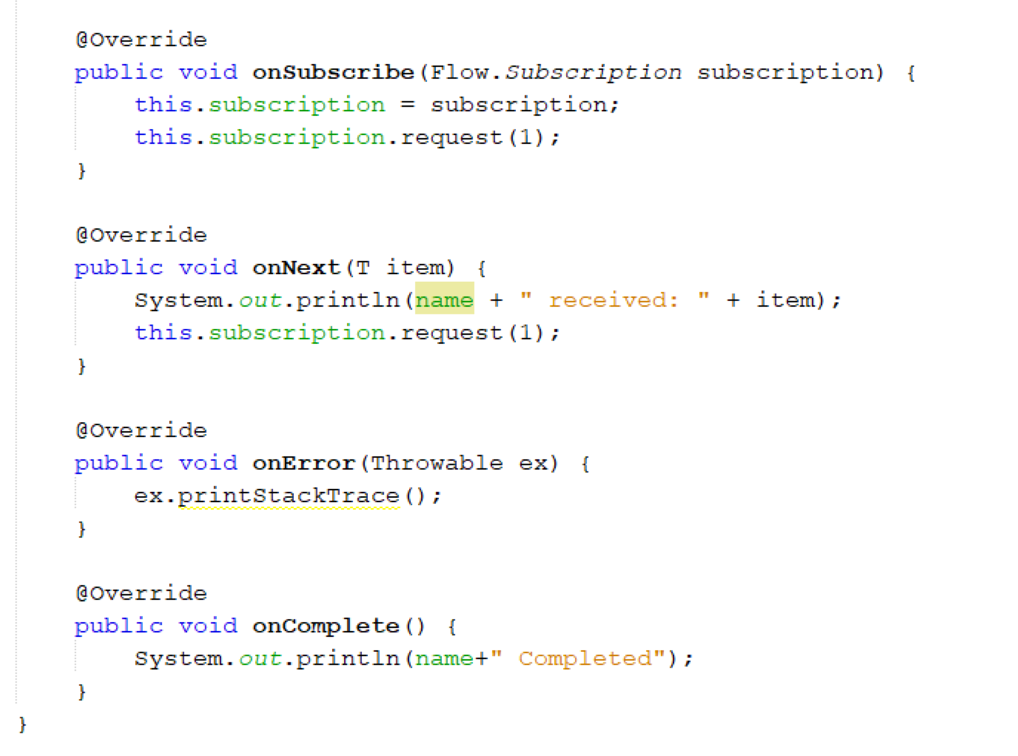
Build Pub Sub Architecture using the Flow API
Create a demo subscriber
In the onNext implementation print out the update received and request another update
If you receive an error or a complete message log them

Slide 21
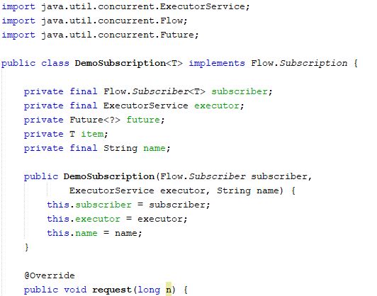
Build Pub Sub Architecture using the Flow API
Create a demo subscription
We have a reference to the Subscriber, the subscription name a and an executor service that are all created in the constructor

Slide 22
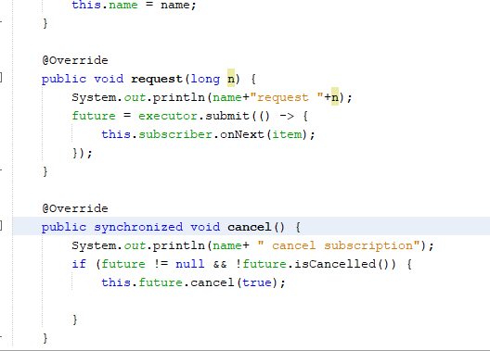
Build Pub Sub Architecture using the Flow API
Create a demo subscription
We then implement the request and cancel methods of the subscription

Slide 23
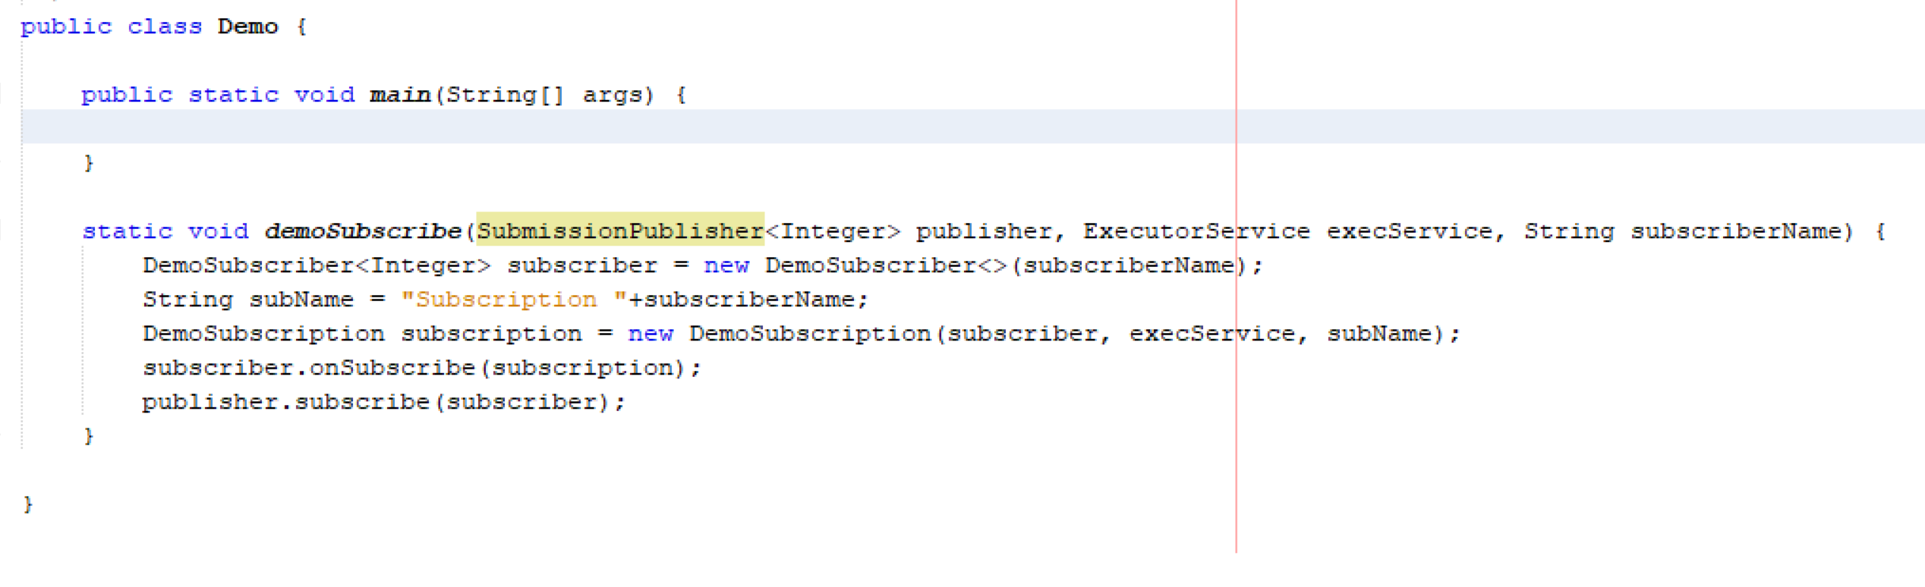
Build Pub Sub Architecture using the Flow API
Create a demo class to test the architecture
First implement a demoSubscribe method which will capture all the behaviour required to register a subscriber with a publisher

Slide 24
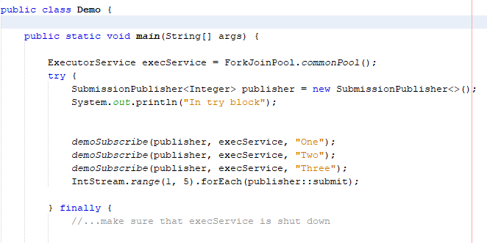
Build Pub Sub Architecture using the Flow API
Create a demo class to test the architecture
Then start to build up some subscriptions with a SubmissionPublisher object
Instead of creating our own implementation of the Flow.Publisher<T> interface, we can use the SubmissionPublisher<T> class from the java.util.concurrent package
Another detail to note is that the SubmissionPublisher<T> class has the submit(T item) method that, according to Javadoc (https://docs.oracle.com/javase/10/docs/api/java/util/concurrent/SubmissionPublisher.html):
"publishes the given item to each current subscriber by asynchronously invoking its onNext() method, blocking uninterruptibly while resources for any subscriber are unavailable."
This way, the SubmissionPublisher<T> class submits items to the current subscribers until it is closed.
This allows item generators to act as reactive-streams publishers.

Slide 25
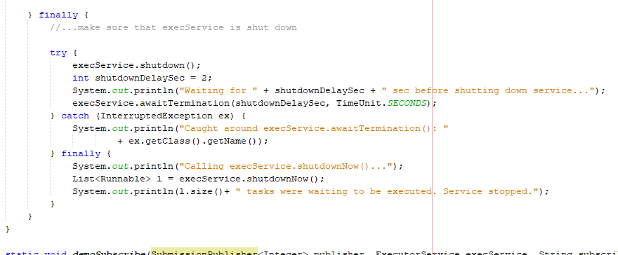
Build Pub Sub Architecture using the Flow API
Create a demo class to test the architecture
In a finally block after the try block implement the following code to manage the shutdown of the executor service

Slide 27


